Slide 1
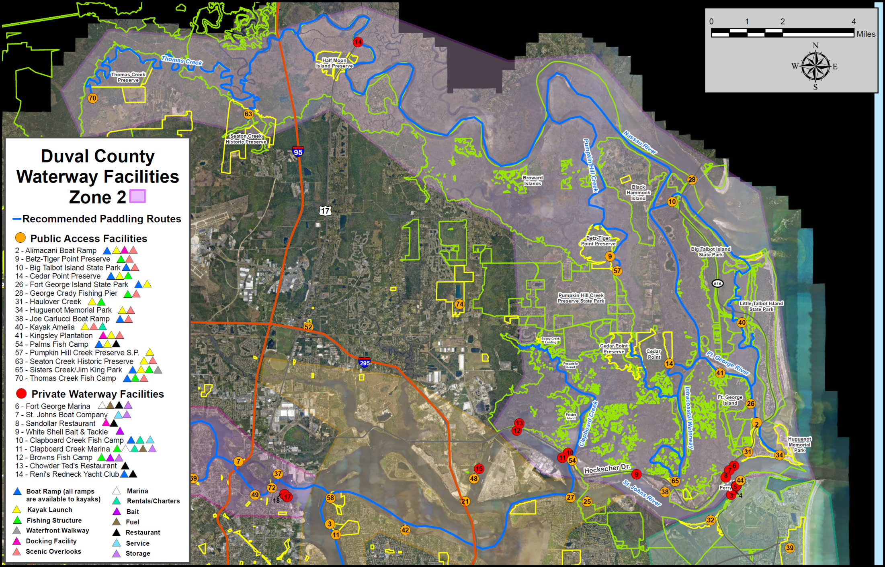

Slide 2
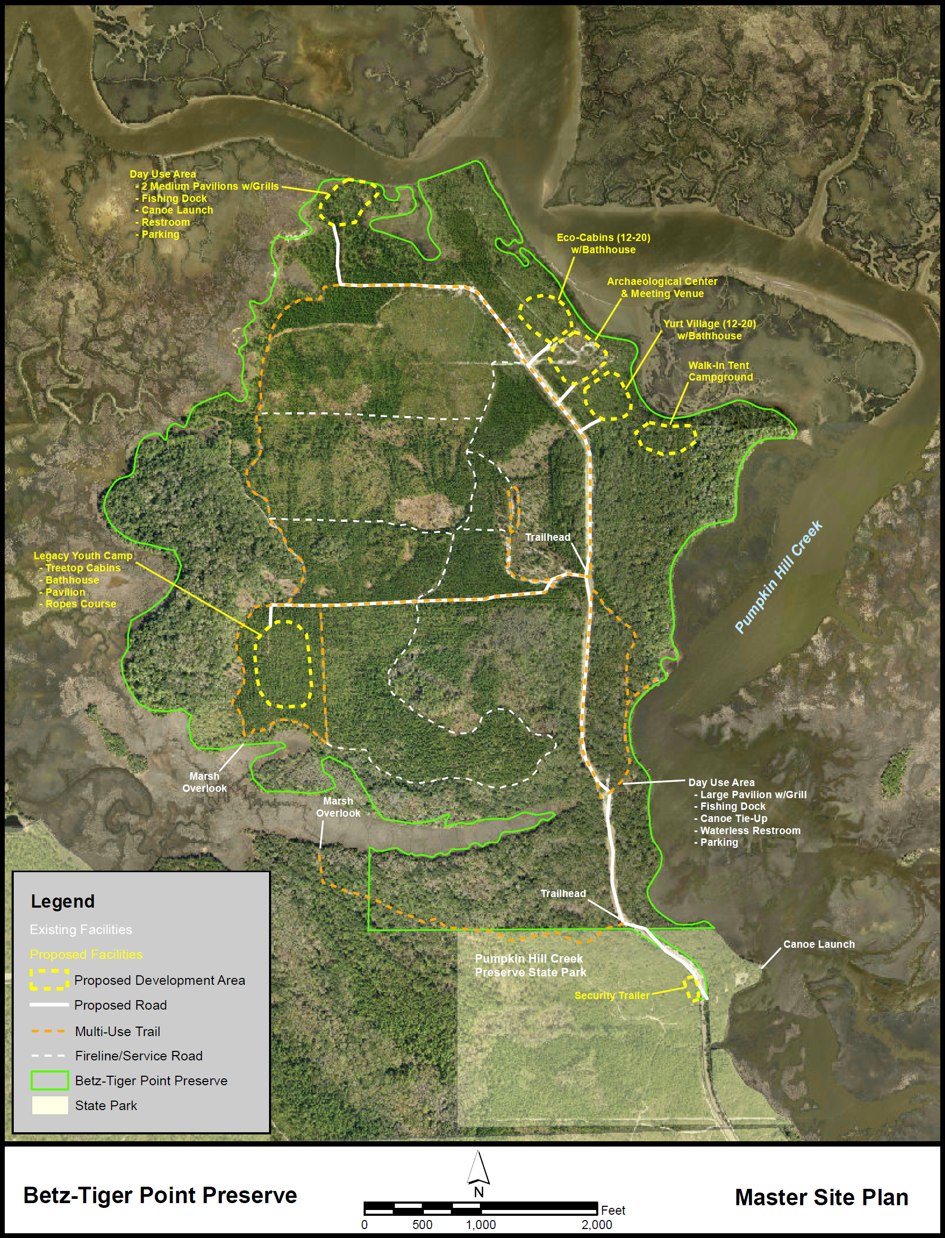
Existing Facilities
Trailhead parking lot
6.6 miles of trail
Picnic Pavilion w/grill
Restroom
Scenic overlook/fishing platform
Canoe tie-up
Scattered trail benches & horse rails
Next Phase (proposed CIP FY22/23)
New day-use area with:
Road improvements
Picnic shelters
Kayak launch
Scenic overlook & fishing platform
Restroom
Parking lot

Slide 3
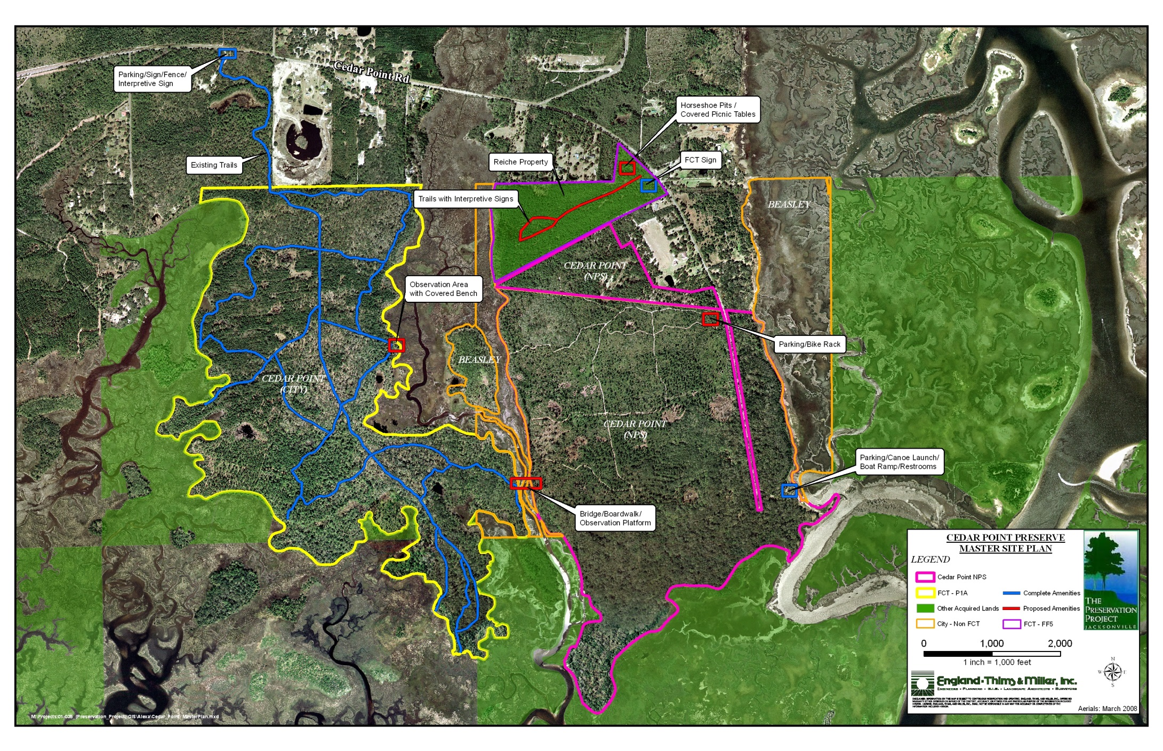
Existing Facilities (COJ)
Trailhead parking lot
6.3 miles of trail w/connection to 16 miles at PHCPSP
Scattered picnic tables, benches
& horse rails
Existing Facilities (NPS)
Boat Ramp/Kayak Launch
4 miles of trail
Parking & restroom
Planned Improvements
Pedestrian bridge connecting COJ & NPS trail systems
New trailhead & amenities @ Reiche property (COJ)

Slide 4
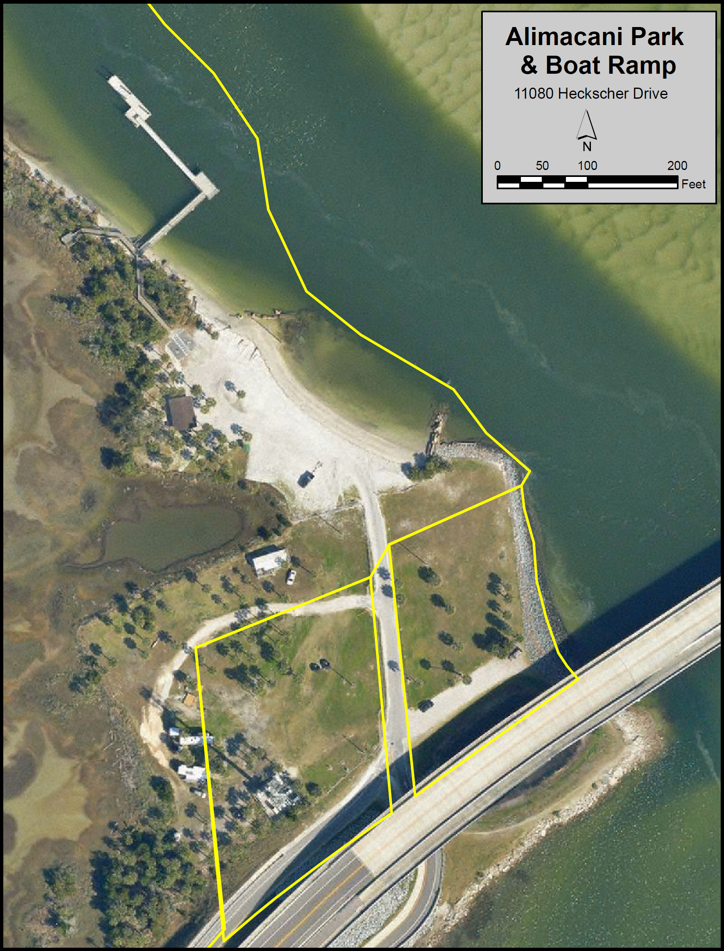
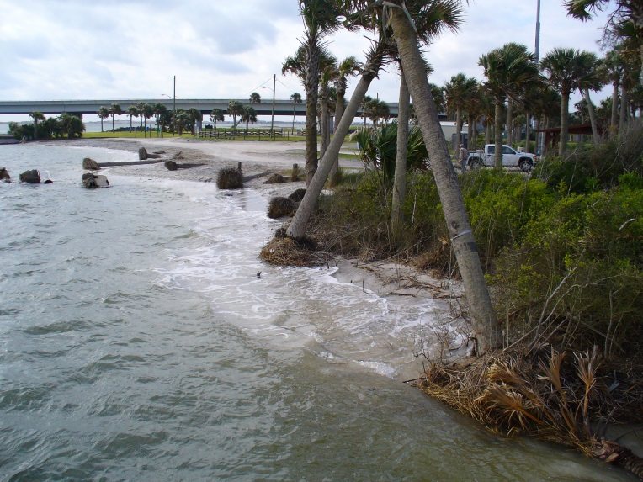
Existing Facilities
Shoreline Boat Ramp & Kayak Launch
Boat Dock w/Scenic overlooks
Parking lot
Picnic Pavilion
Next Phase (proposed CIP FY22/23)
Shoreline revetment
Improvements to boat ramp facility

Slide 5
